Slide 1
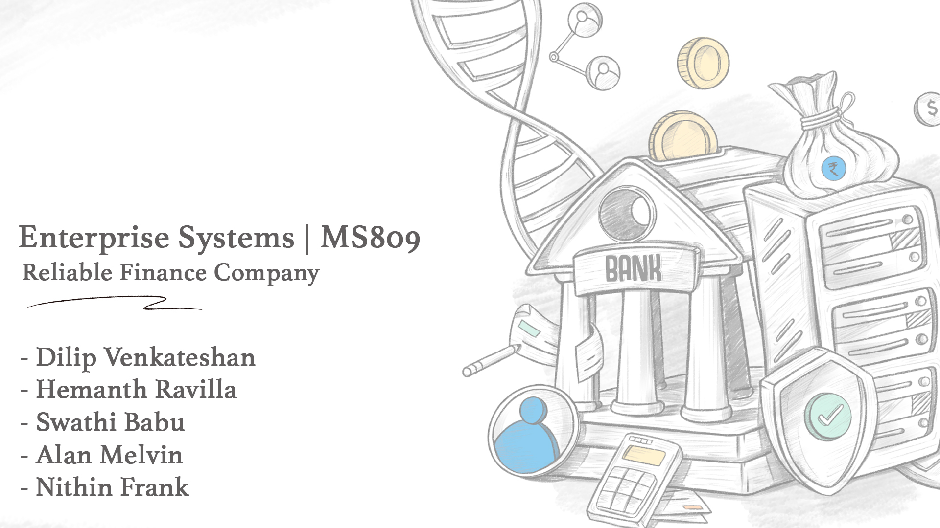

Slide 2
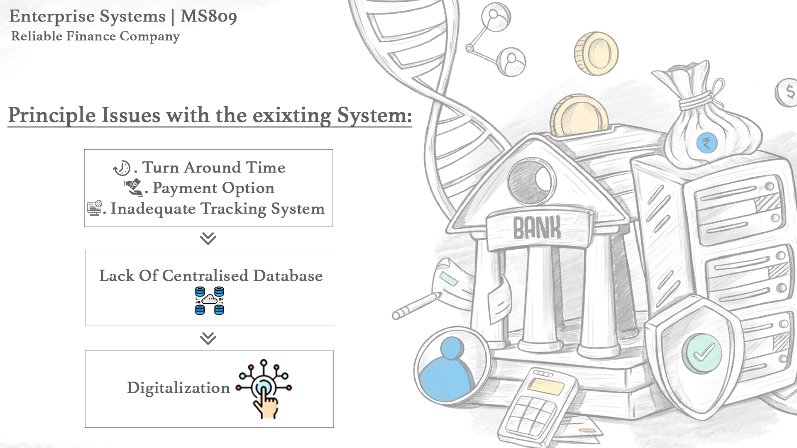

Slide 3
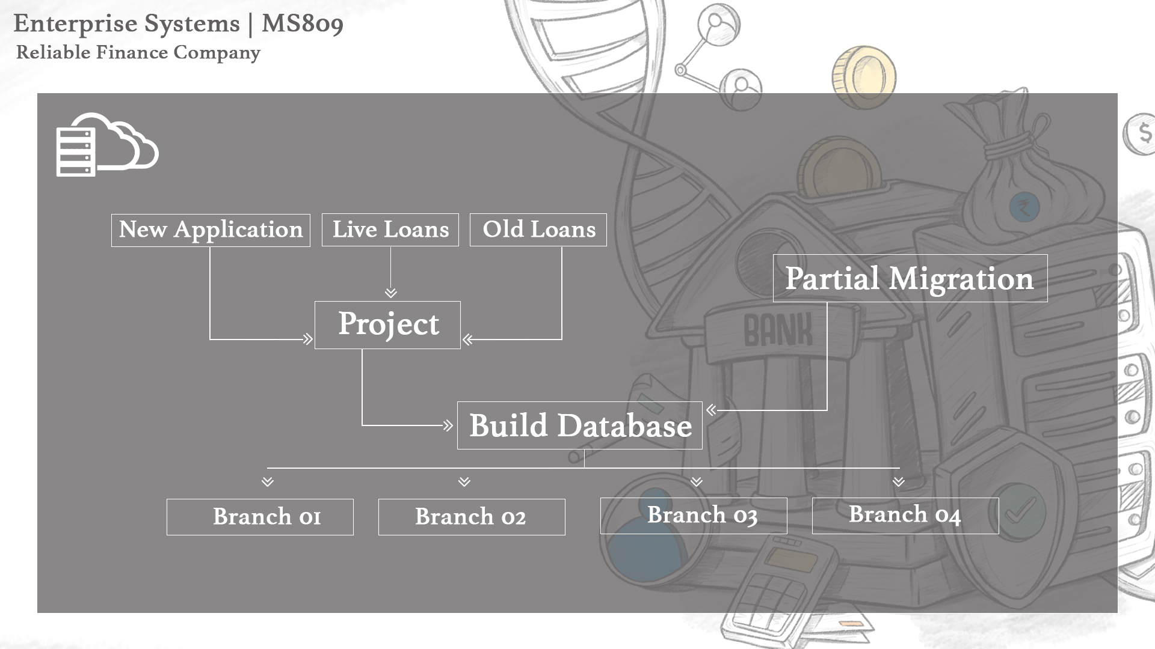

Slide 4
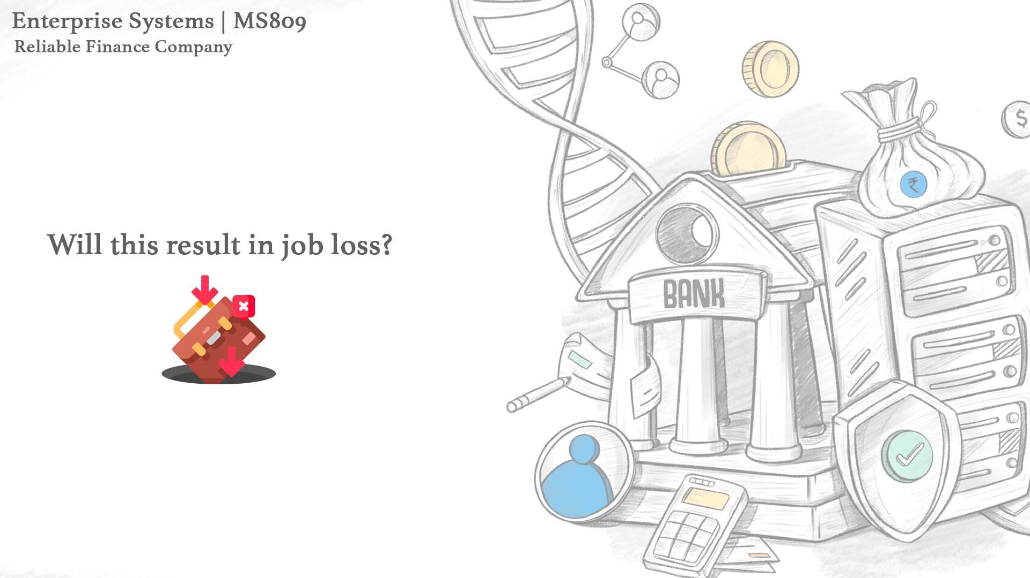
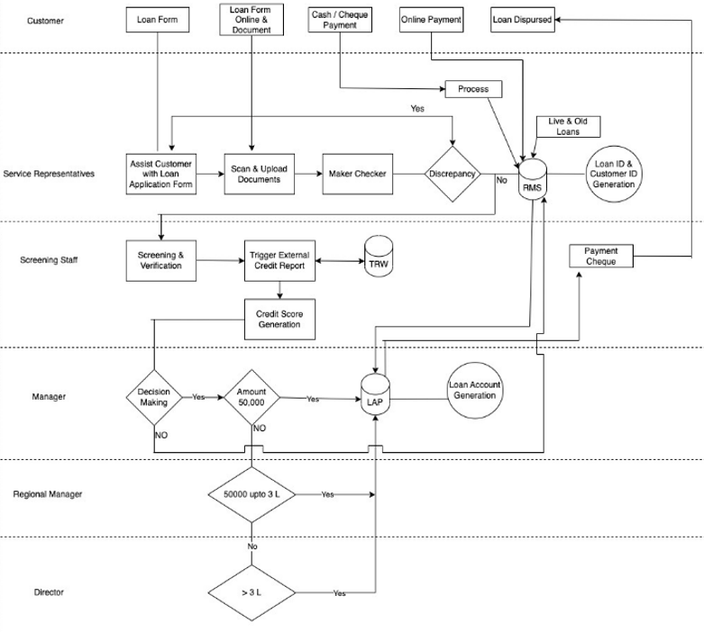
Re-engineered model for RFC

Slide 5
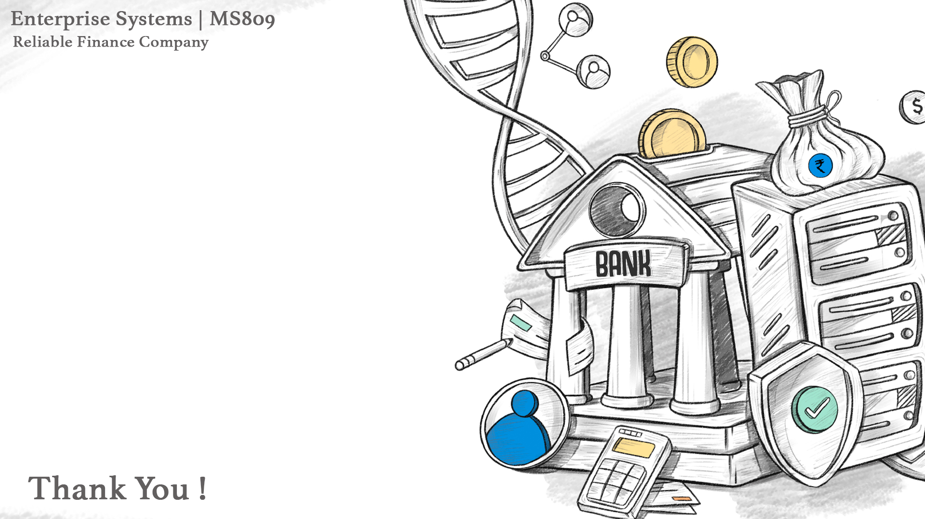
Performance improvements for RFC based on suggested models
1. By following the proposed restructured process, the duration of LAP can be reduced to 2-3 days thus attracting more prospects - increased revenue.
2. Customers do not have to approach the organization for incorrect payment reminders even though it has paid off - Reduction in manual work, which can be put to some other use and improvement in RFC’s trust and reliability.
3. By keeping track of the payments precisely with the new process and centralized database, the ‘uncollectible amount’ which results in a loss to the company can be identified thus resulting in increased revenue.
4. Improvement in performance, productivity, and scalability which supports the expansion of RFC.
5. Timely loan repayment with the introduction of SMS/Email reminders ensures a correct balance sheet and reduces re-payment failures and delinquencies.
6. Identifying and segregating delinquent customers with the help of TRW credit score report for the operations team which helps in customer profiling.
7. Timely and rapid updating of loan payments both by branch and home office in the central database ensure no mismatch, error correction, and additional clerical work needed which optimizes resources, saves more time, and improves productibility.

